Slide 1
CS4031 Compiler Construction Lecture 5-Chapter 3
Faryal Saud
Lecturer, Department of Computer Science
FAST NUCES CFD

Slide 2
Token
Lets take the example in which we count the numbers of tokens
int main ( )
{
//here we declare the variables
int a1 = 30 , b1 = 40; // variable declaration
if ( b1 > a1)
return b1;
else
return a1;
}

Slide 3
Token
Lets take the example in which we count the numbers of tokens
int main ( )
We have four tokens
int
main
(
)
Token | Token count
int | 1
Main | 2
( | 3
) | 4

Slide 4
Token
Lets take the example in which we count the numbers of tokens
int main ( )
{
//here we declare the variables
int a1 = 30 , b1 = 40; // variable declaration
Here we ignore the comments and white spaces

Slide 5
Error Recovery in Lexical Analysis
Generally, errors often detected in a lexical analysis are as follows:
Numeric literals that are too long
Long identifiers (often a warning is given)
Input characters that are not in the source language

Slide 6
Strategy to implement the lexical analyzer
Designing a lexical analyzer either by hand or automated tools mainly involves two steps
Describe rules for tokens using regular expressions.
Design a recognizer for such rules, that is, for tokens. Designing a recognizer corresponds to converting regular expressions to Finite Automata. The processing can be speeded if the regular expression is represented in Deterministic Finite Automata. This involves the following steps:
• Convert regular expression to NFA with ε
• Convert NFA with ε to NFA without ε
• Convert NFA to DFA

Slide 7
Table Encoding
b
1
a
2
a
3
 | A | B
1 | 2 | Error
2 | 3 | 2
3 | error | Error

Slide 8
Simulating FAs
trans_table[NSTATES][NCHARS];
accept_states[NSTATES];
state = INITIAL;
while(state != err){
c = input.read();
if(c == EOF ) break;
state=trans_table[state][c];
}
return accept_states[state];

Slide 9
Some Previous Concept
In this step, we revise the concept of automata
DFA
NFA
Epislon NFA
NFA to DFA
Minimization of DFA

Slide 10
NFA
NFA can get into multiple states
Rule: NFA accepts if it can get in a final state
1
0
1
A
B
C
0

Slide 11
Execution of DFA
A DFA
can take only one path through the state graph.
Completely determined by input.

Slide 12
NFA vs DFA
NFAs and DFAs recognize the same set of languages (regular languages)
DFAs are easier to implement – table driven.
For a given language, the NFA can be simpler than the DFA.
DFA can be exponentially larger than NFA.

Slide 13
Construction of RE to NFA a(b+c)*
ε
b
s₄
s₅
ε
ε
a
ε
ε
ε
s₀
s₁
s₂
s₃
s₈
s₉
ε
s₆
c
s₇
ε
ε

Slide 14
Optimized Acceptor
RE
R
RE=>NFA
NFA=>DFA
Min. DFA
yes, if w ∈ L(R)
input string
Simulate DFA
w
no, if w ∉ L(R)
14

Slide 15
Using flex
Provide a specification file
Flex reads this file and produces C or C++ output file contains the scanner
The file consist of three sections
C or C++ and flex definition
Token definitions and actions
User code

Slide 16
Problem scanner
In order to recognize a token, a scanner has to look ahead several characters from the current character many times.
For example
“char” is a keyword in C, while the term “chap” may be a variable name.
When the character “c” is encountered, the scanner cannot decide whether it is a variable, keyword, or function name until it reads three more characters.

Slide 17
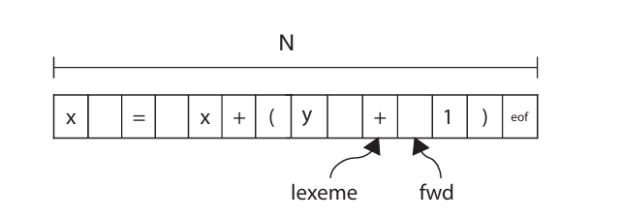
Input buffering
Input buffering is an important concept in compiler design that refers to the way in which the compiler reads input from the source code.
Need of Buffering
In many cases, the compiler reads input one character at a time, which can be a slow and inefficient process.
Input buffering is a technique that allows the compiler to read input in larger chunks, which can improve performance and reduce overhead.

Slide 18
Buffering
Input string to source code (as we discussed previously we stored the whole string in the buffer for lexical analyzer phase to create the tokens)
Int ( )
{
}
Token Lexemes
i | n | t |  | m | a | i | n | ( | ) |  | { | }

Slide 19
Buffering
Lexem Begin Pointer (red color pointer)
Points to the beginning of every token
Forward Pointer (Black color pointer)
points every next character in the input string
Token Lexemes
i | n | t |  | m | a | i | n | ( | ) |  | { | }

Slide 20
Buffering
Token Lexemes
i | n | t |  | m | a | i | n | ( | ) |  | { | }
Token Lexemes
i | n | t |  | m | a | i | n | ( | ) |  | { | }

Slide 21
Buffering
Token Lexemes
i | n | t |  | m | a | i | n | ( | ) |  | { | }

Slide 22
Working of input buffering
Two pointer should be used for buffering
Two pointers “lexeme” and “fwd” to the input buffer are maintained.
The string of characters enclosed between the two pointers is the current lexeme.
To find the lexeme, first initialize both the pointers with the first character of the input.
Keep incrementing the fwd pointer until a match for the pattern is found.
Once a character not matching is found, stop incrementing the pointer and extract the string between the “lexeme” and “fwd” pointers.

Slide 23
Types of Input Buffering
There are two types of input buffering
Buffer Pairs
Sentinel Value

Slide 24
Buffer Pairs
Buffer is to divide the buffer into two halves. Means N character halves.
1st Half
2nd Half

Slide 25
Sentinel Value
A sentinel is a special character, often used at the end of the input buffer, to mark its boundaries.
Sentinels are essential for two primary reasons:
1. Boundary Detection
2. Safety Against Buffer Overflow

Slide 26
Sentinels Buffering
Sentinels are essential for two primary reasons:
1. Boundary Detection: Sentinels provide a clear demarcation between the end of the input buffer and the start of the output buffer. This ensures that the compiler knows where to stop reading characters and where to begin forming lexemes.
2. Safety Against Buffer Overflow: Sentinels act as guards against buffer overflow. By signaling the end of the input buffer, they prevent the input buffer from overflowing into the output buffer, which could lead to data corruption and unpredictable behavior.

Slide 27
Lexical Analyzer Generator
The lexical analysis process can automated, we only need to specify
Regular expression to tokens
Rule priorities for multiple longest match cases
Flex is used to generates the lexical analyzer in C or C++

Slide 28
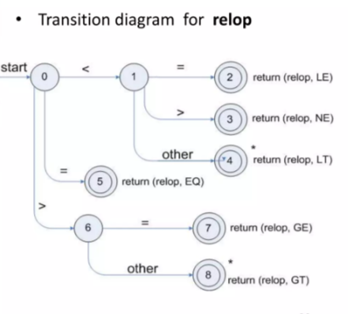
Recognition of tokens
To understand the recognition of tokens, consider the regular expression of tokens together with the attributes values
Lexemes | Token Names | Attribute Value
< | Relop | LT
<= | Relop | LE
= | Relop | EQ
<> | Relop | NE
> | Relop | GT
>= | Relop | GE
Relop means relational operator

Slide 29
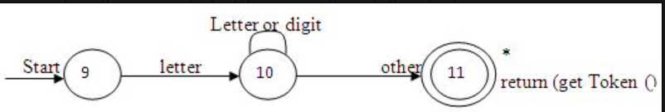
Transition Diagram for Identifiers

Slide 30
Introduction to Lex
Lex- Definition Section
contain definition and included code
Definition is like macros and have the following form
Included code is all code included %{ %}
Name | Translation
Digit | [0-9]
Number | {digit} {digit}*

Slide 31
Lex Program
A Lex program is separated into three sections by %% delimiters. The formal of Lex source is as follows:
{ definitions }
%%
{ rules }
%%
{ user subroutines }

Slide 32
Definition
The definition section contains the declaration of variables, regular definitions, manifest constants.
In the definition section, text is enclosed in “%{ %}” brackets.
Anything written in this brackets is copied directly to the file lex.yy.c
Example:
#include<stadio.h>
#include<tokendef.h>

Slide 33
Rules
The rules section contains a series of rules in the form: pattern action and pattern must be unintended and action begin on the same line in {} brackets.
The rule section is enclosed in “%% %%”

Slide 34
Rules
"void" {return(TOK_VOID);}
"int" {return(TOK_INT);}
"if" {return(TOK_IF);}
"else" {return(TOK_ELSE);}
"while"{return(TOK_WHILE)};
"<=" {return(TOK_LE);}

Slide 35
Rules
">=" {return(TOK_GE);}
"==" {return(TOK_EQ);}
"!=" {return(TOK_NE);}
{D}+ {return(TOK_INT);}
{id} {return(TOK_ID);}
[\n]|[\t]|[ ] ;
%%

Slide 36
YYWRAP ( )
yywrap( )
Function yywrap is called by lex when input is exhausted. Return 1 if you are done or 0 if more processing is required. Every C program requires a main function. In this case we simply call yylex that is the main entry-point for lex.

Slide 37
User Code Section
int main ( )
{
printf(“enter a string”);
yylex( );
}

Slide 38
Command to install Flex in Ubuntu
Sudo apt-get update
Sudo apt install flex
Sudo apt install bison

